Slide 1
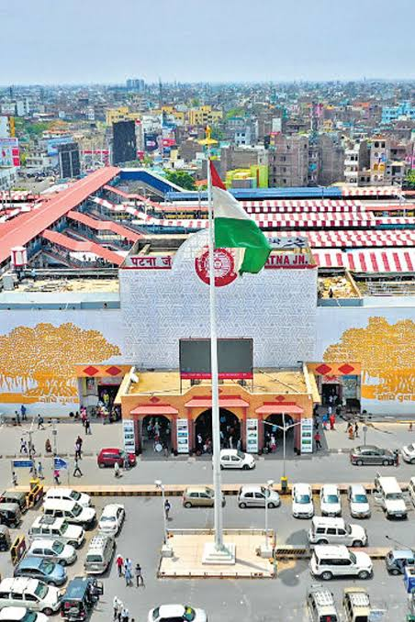
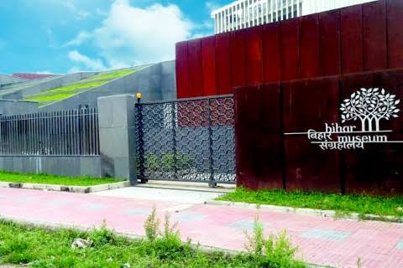
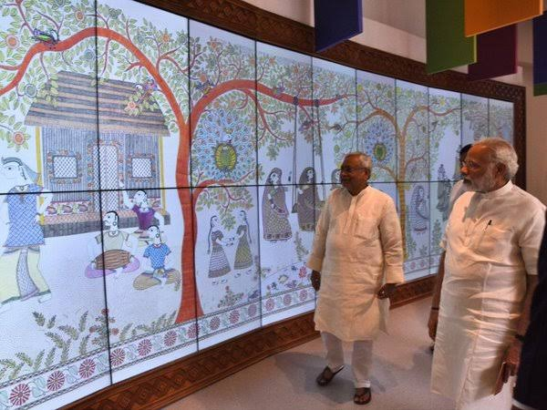
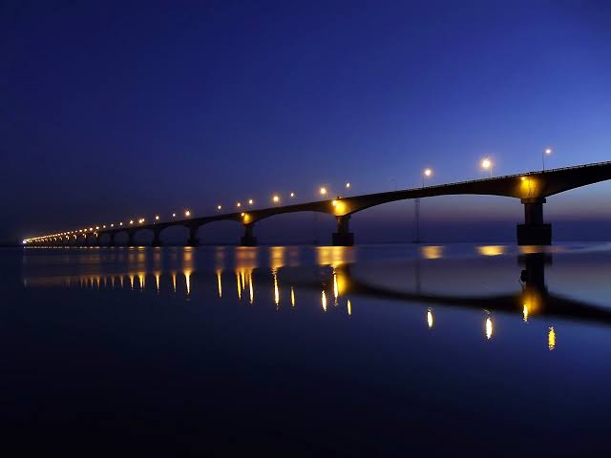
BIHAR
Welcome
To
An underrated state of independent India
Modern day India has conveniently forgotten that Bihar has a historical significance in world history since ancient period.

Slide 2
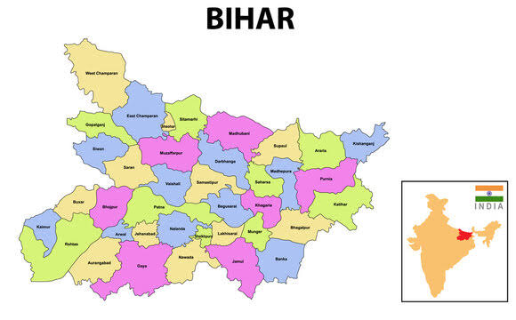
CONTENT
INTRODUCTION
HISTORY
WHY IS BIHAR FAMOUS?
MAIN FESTIVALS AND CUISINE
TOURIST ATTRACTION

Slide 3
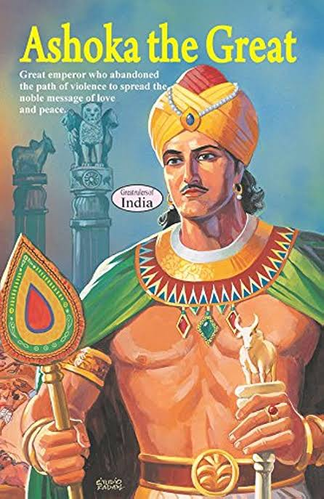
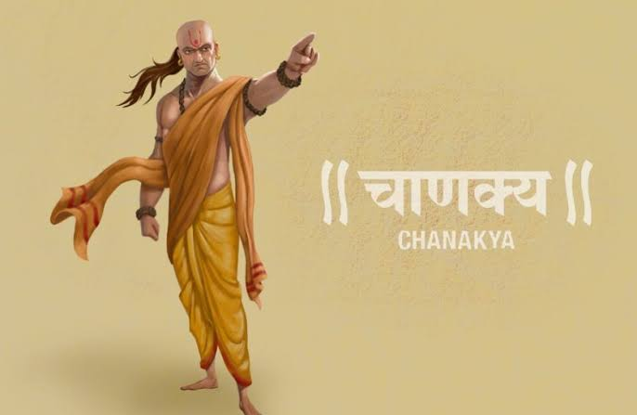
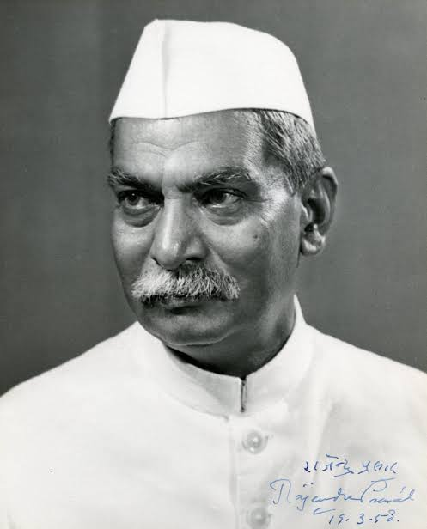

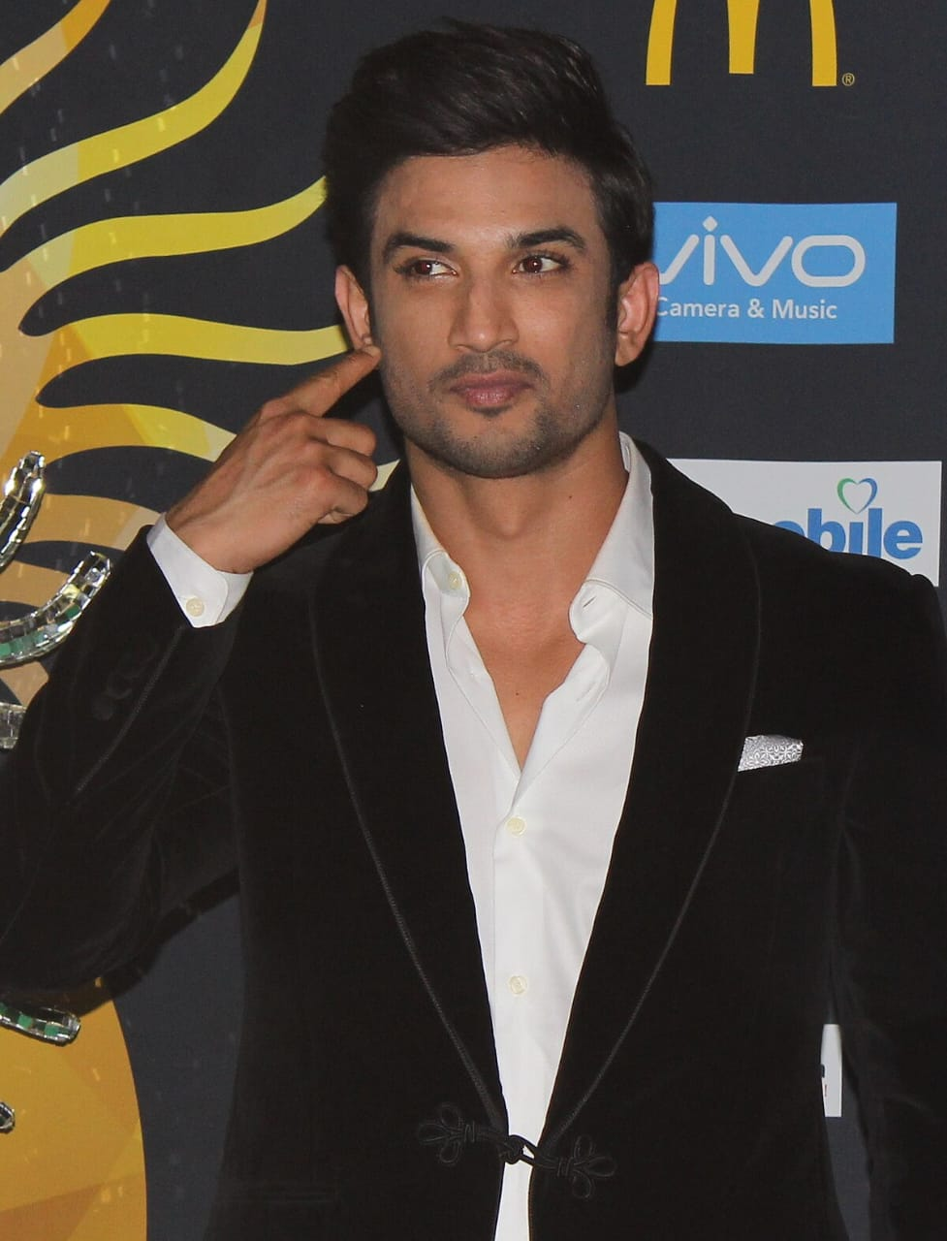
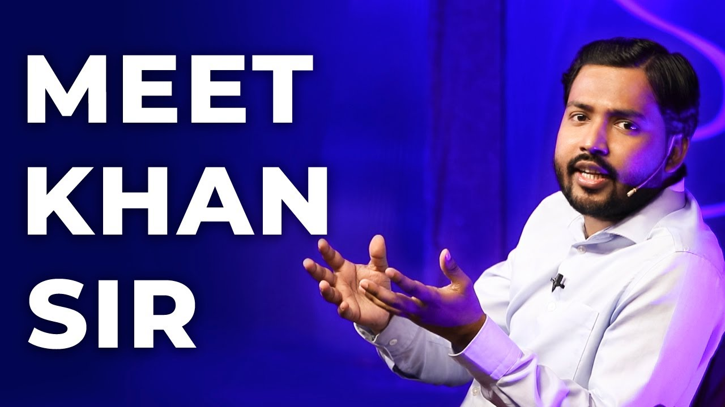

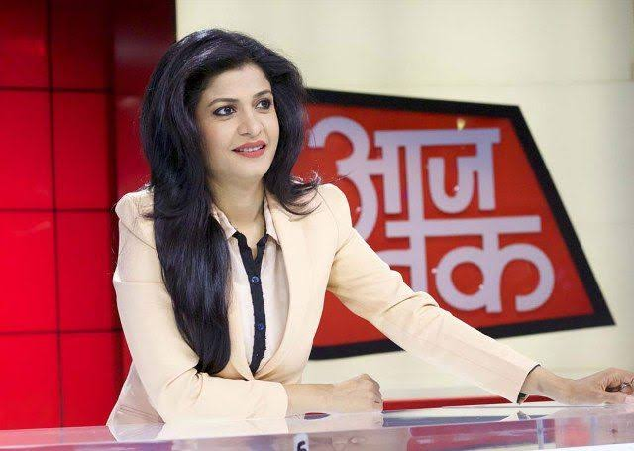
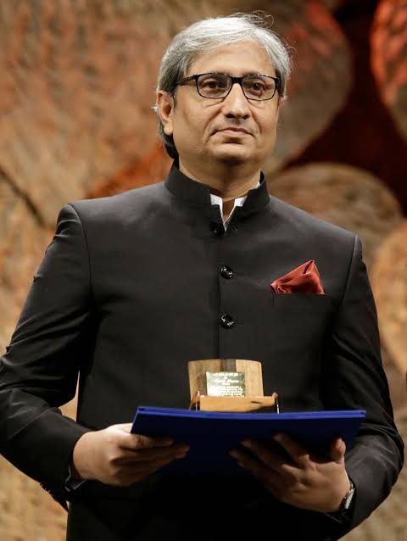
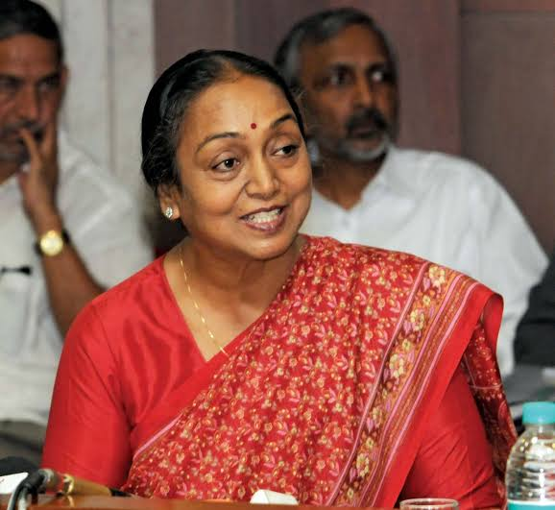

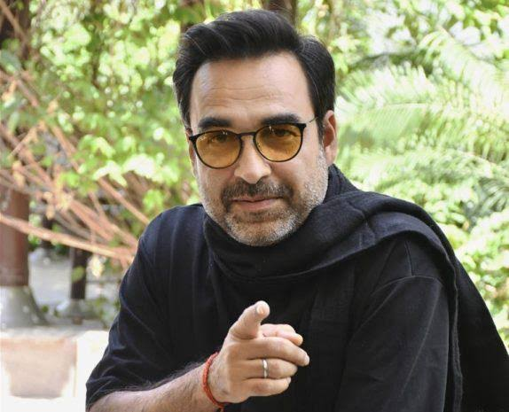
SOME FAMOUS AND IMPORTANT PERSONALITIES OF BIHAR

Slide 4
INTRODUCTION
Bihar – the name is derived from a Sanskrit word “Vihara”
also known as land of Nirvana (Moksha).
Located in the fertile Gangetic plains in the eastern part of the country.
Capital – Patna , situated on the bank of holy river Ganga.
9th largest state – area wise and 2nd population wise.
Bounded by Nepal in north , Orissa in south , WB in west and UP in east.
Hindi , Bhojpuri , Maithili are major spoken language.

Slide 5
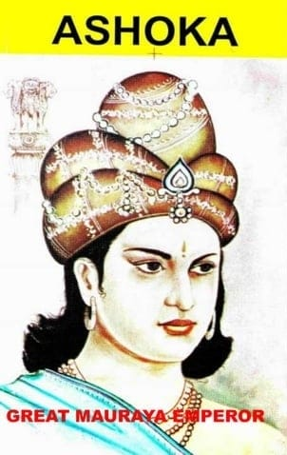
HISTORY
Ancient Bihar – Magadha (capital – Pataliputra ),was the
center of power , learning, and culture in India for 1000 years.
Land of Mauryan empire (321 – 185 BC ; India’s first empire) – established by Chandragupta Maurya under political genius Chanakya.
Later Samrat Asoka expanded it and made it biggest empire and become biggest emperor in India .
Buddhism & Jainism religion & revolution in Bihar –
Prince Gautama attained enlightenment , become Buddha , at present Bodh Gaya ,
a town in central Bihar.
Lord Mahavira , the founder of Jainism was born and attained death in Vaishali , Bihar.
The 10th and last Guru of Sikhs , Guru Gobind Singh was born and attained the sainthood of Sikhism at Patna Saheb in Bihar.

Slide 6
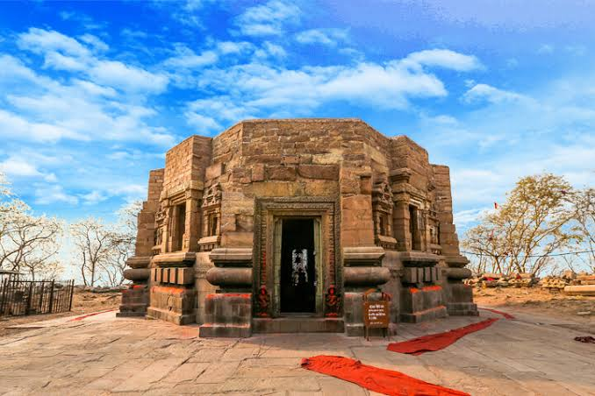
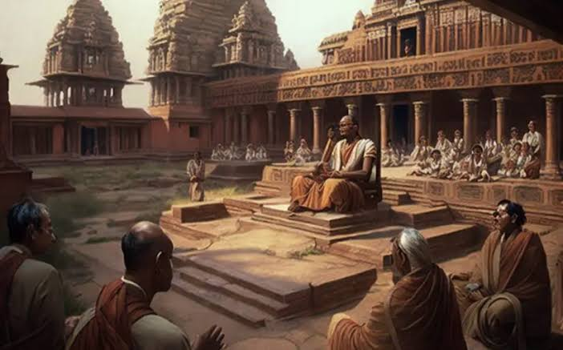
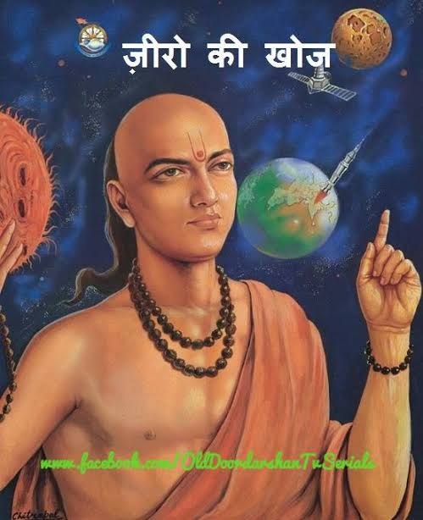
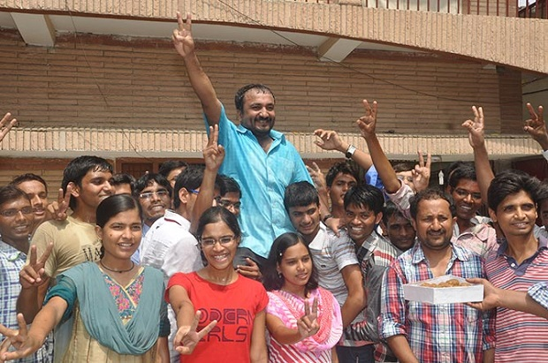
Why was/is Bihar famous?
Mundeshwari temple
Nalanda university
1.Home of oldest HINDU temple -
Mundeshwari Devi temple.
2.Epicenter of knowledge from ancient time –
Nalanda university which attracted and attracts students from all of the world is in Patna.
Nalanda university had biggest library of the world which was set on fire by Mughals which took 3 months to burn.
3. Excellent in Mathematics –
Great mathematician Aryabhata who discovered zero and calculated value of pi(3.14) was from Bihar.
At present Anand Kumar a mathematician who runs an IIT coaching called ‘super 30’ for free who can’t afford heavy fee.
A movie ‘Super 30’ featuring Hrithik Roshan was made on Anand kumar

Slide 7
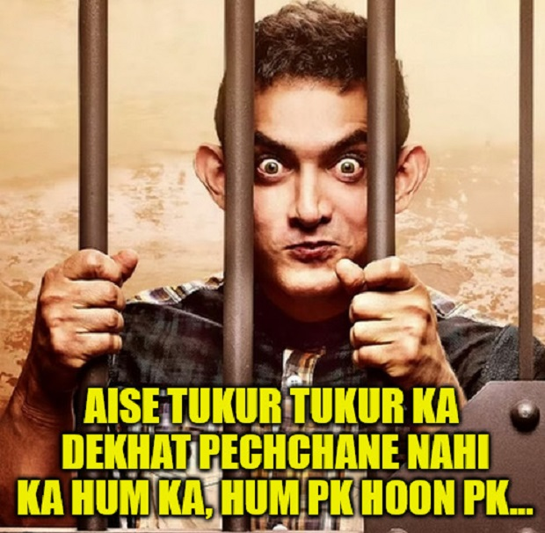
4. IAS/IPS producing factory –
Biharis are on the top in qualifying toughest exam of India (UPSC)
to gain prestigious services of India.
5. Unique Bihari accent –
How are you?----kaise ho?----kaisan bada?
What is your name?---kya name hai tumhara?---ka nam ha Tahar?
My name is Ravi-----mera name Ravi hai----humar nam Ravi ha.
Nice to meet you-----tum se milke acha laga----Tohase milke thik lagal.
Which gains tremendous popularity after PK Movie.
6. Politics –
Indian politics is unimaginable without Bihar it gave our 1st president Dr . RAJENDRA PRASAD and first ever female Lok Sabha speaker Meira Kumar and other famous leaders like Lalu Prasad Yadav.
7. Largest cattle fair –
The SonePur cattle fair – held on the bank of Gandaki River in the town SonePur.

Slide 8
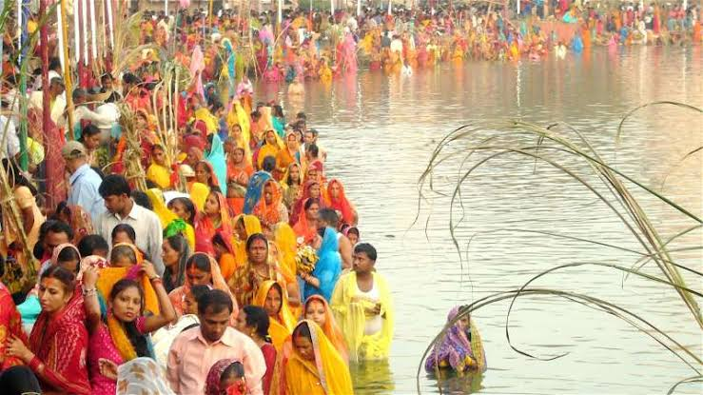
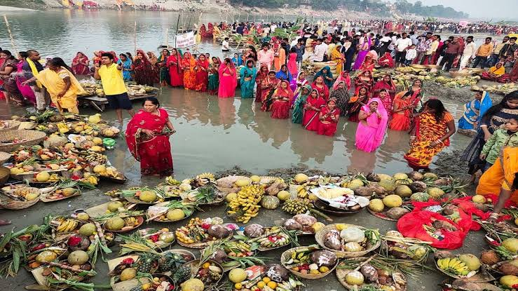
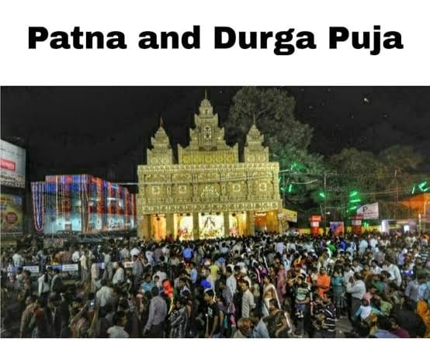
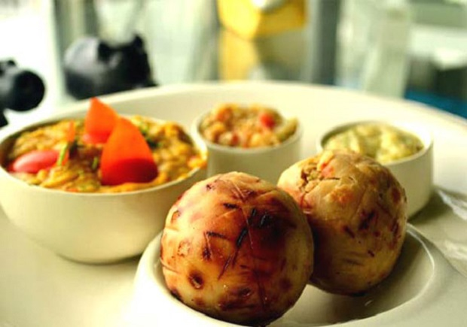
main Festivals and Cuisine
Festivals-
Chhath puja- a series of four day festival dedicated to God sun.
Durga puja –
Saraswati puja -
CUISINE
Bihar is known for its flavory and spicy cuisine .
Some of the popular dishes includes litti chokha , sattu
and mouth watering sweets like padadi , khaja and peda.

Slide 9
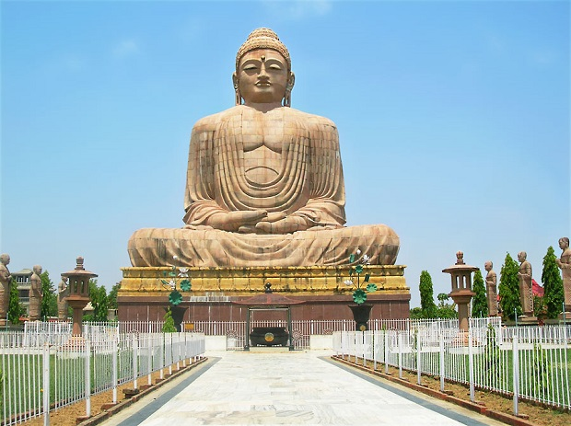

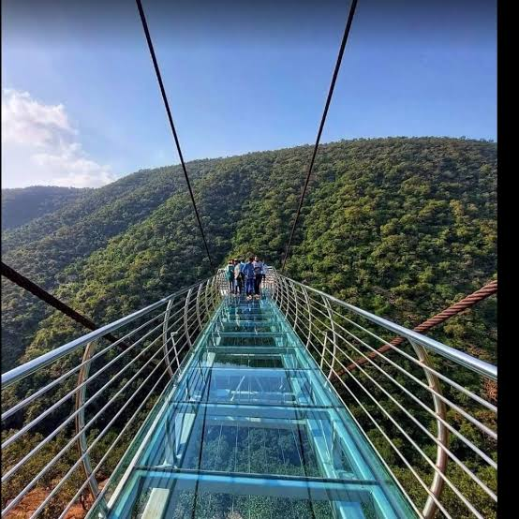
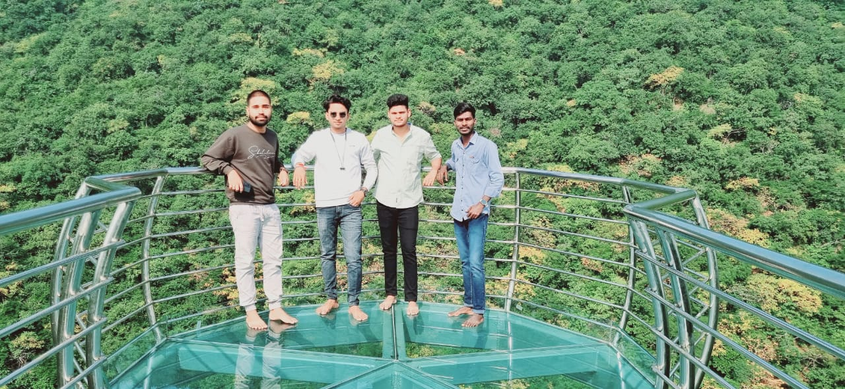
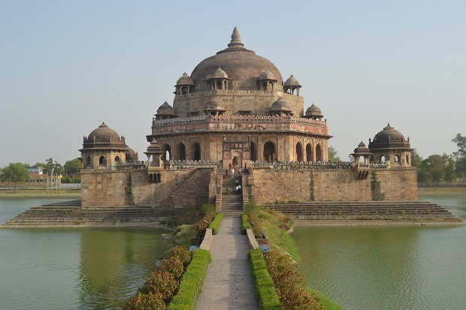
TOURIST DESTINATION
The Great Buddha Statue , Gaya
Tomb Sher Shah Suri
Glass Bridge (sky walk) – Rajgir ,only sky walk after china’s glass bridge.

Slide 10
CONCLUSION
Bihar is a state with immense potential and opportunities.
It’s rich cultural heritage can be forgotten but cannot be hidden.
Bihar has equal and important contribution in the independence and development of India.
Bihar has potential to emerge as one of the best state of India , if it has given proper political guidance.

Slide 11
I FEEL PROUD ON MY BIHAR……
THANK YOU!
I AM HAPPYAND LUCKY BECAUSE I AM TAGGED AS BIHARI……

